Slide 1
ISEV Book Publishing
Company:
Database Design & Development
Team 3: Dylan Lam (Team Leader), Joyce Lam (Data Administrator), Zihong Huang (Database Developer), Noe Jimenez (Database Developer)
CIS 3050-01 | Fall 2020

Slide 2
What to Expect
Table of Contents
Scenario -> 3
Business Rules -> 3
Entity and Relationship types -> 4
ER Diagram -> 5
Tables & Attributes -> 6
Referential Integrity -> 6
Functional Dependency Analysis -> 7
Normalization -> 8
Database Creation Script (DDL) -> 9-13
Database Description -> 14-15
Database Instances -> 16-18
DML Statements -> 19-20

Slide 3
Scenario & Business Rules
Scenario/ Purpose: An online book store database needs to keep track of orders, inventory, and its customers. Therefore, we created this database to resolve this problem.
Business Rules:
One customer may or may not place many orders.
One order must be placed by one and only one customer.
One order must contain one or more item.
One item may or may not be in many orders.
One customer must be either a business or individual customer.
One business customer or individual customer must be a customer.

Slide 4
Entity & Relationship Types
 | Customer | Order | Item | Business Customer | Individual Customer
Customer | --- | places | --- | must be either | must be either
Order | placed by | --- | contains | --- | ---
Item | --- | must be in | --- | --- | ---
Business Customer | must be a | --- | --- | --- | ---
Individual Customer | must be a | --- | --- | --- | ---

Slide 5
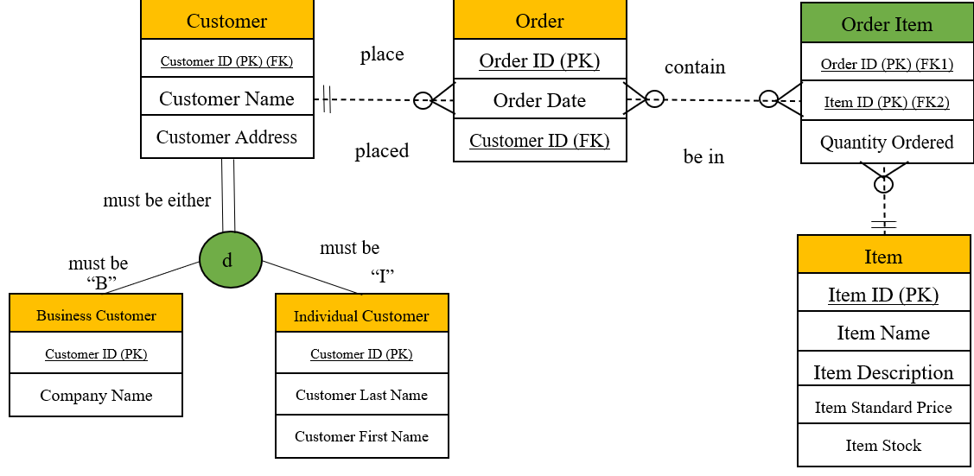
ER Diagram
One customer may or may not place many orders.
One order must be placed by one and only one customer.
One order must contain one or more item.
One item may or may not be in many orders.
One customer must be either a business or individual customer.
One business customer or individual customer must be a customer.

Slide 6
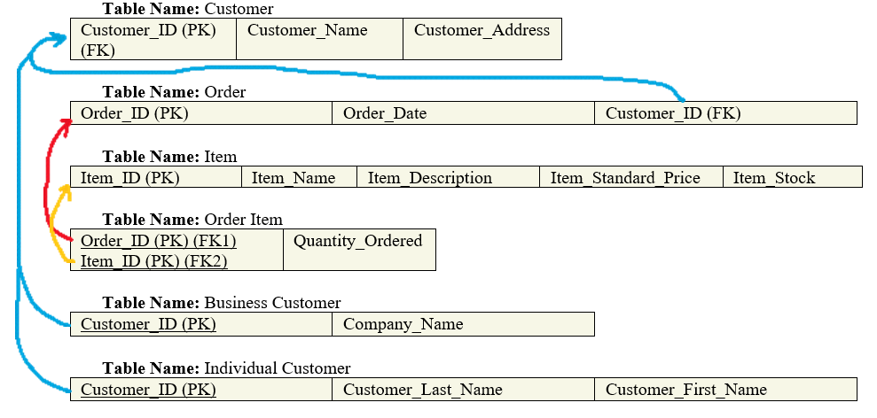
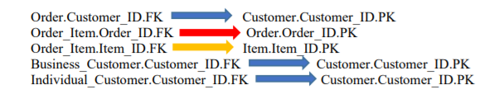
Tables, Attributes, & Referential Integrities

Slide 7
Functional Dependency Analysis
Customer:
Customer_ID -> Customer_Name, Customer_Address [Full dependency]
Order:
Order_ID -> Order_Date, Customer_ID [Full dependency]
Item:
Item: Item_ID -> Item_Name, Item_Description, Item_Standard_Price, Item_Stock [Full dependency]
Order Item:
Order_ID, Item_ID -> Order_Date [Full dependency]
Business_Customer:
customerID -> businessOrderHistory [Full dependency]
Individual_Customer:
customerID -> individualOrderHistory [Full dependency]

Slide 8
Normalization
Table Name | 1NF | 2NF | 3NF
Customer | X | X | X
Order | X | X | X
Item | X | X | X
Order Item | X | X | X
Business Customer | X | X | X
Individual Customer | X | X | X

Slide 9
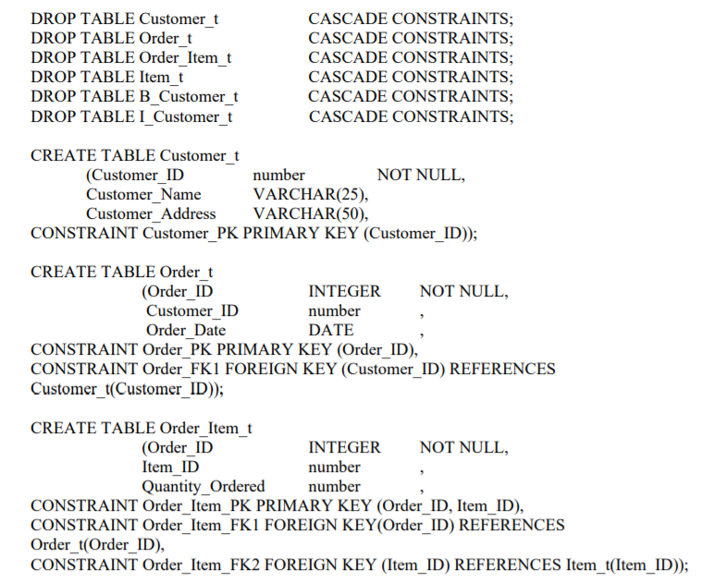
Database Creation Script (DDL)

Slide 10
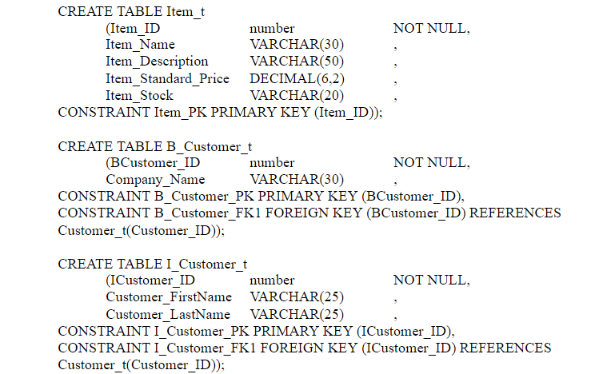
Part 2

Slide 11
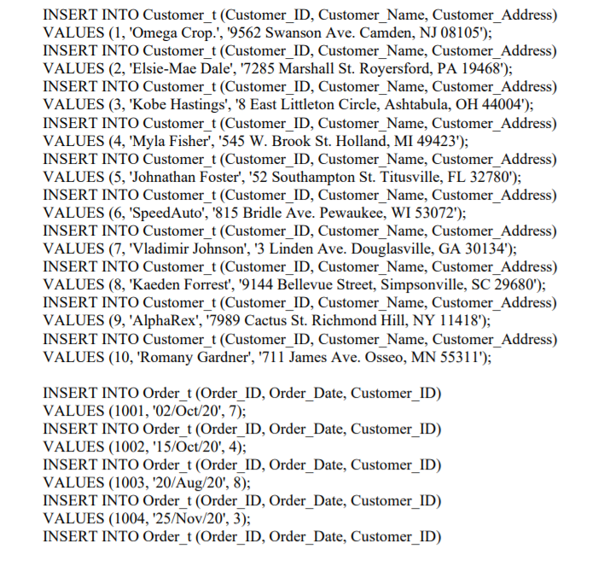
Part 3

Slide 12
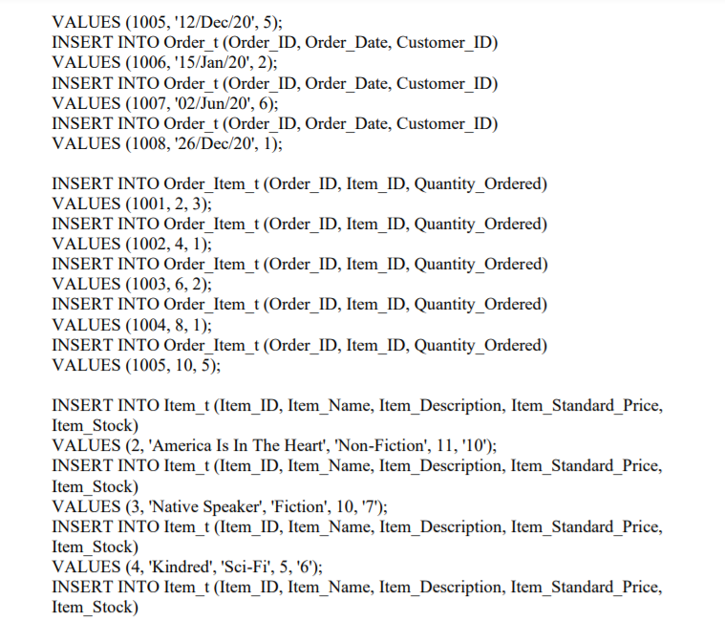
Part 4

Slide 13
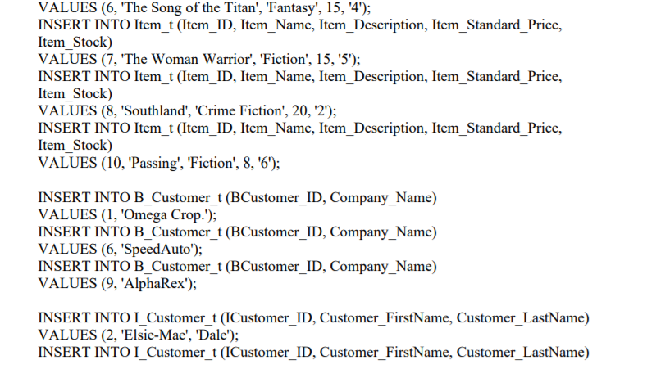
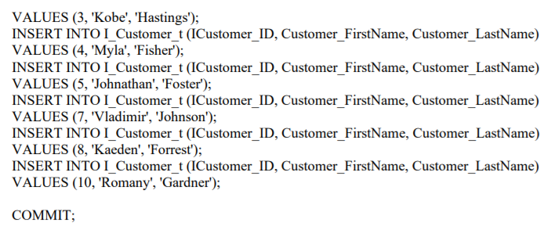
Part 5

Slide 14
Database Description
DESC Customer_t;
Name | Null? | Type
CUSTOMER_ID | NOT NULL | NUMBER
CUSTOMER_NAME |  | VARCHAR2(25)
CUSTOMER_ADDRESS |  | VARCHAR2(50)
DESC B_Customer_t;
Name | Null? | Type
BCUSTOMER_ID | NOT NULL | NUMBER
COMPANY_NAME |  | VARCHAR2(30)
DESC I_Customer_t;
Name | Null? | Type
ICUSTOMER_ID | NOT NULL | NUMBER
CUSTOMER_FIRSTNAME |  | VARCHAR2(25)
CUSTOMER_LASTNAME |  | VARCHAR2(25)
DESC Order_t;
Name | Null? | Type
ORDER_ID | NOT NULL | NUMBER(38)
CUSTOMER_ID |  | NUMBER
ORDER_DATE |  | DATE

Slide 15
Part 2
DESC Item_t;
Name | Null? | Type
ITEM_ID | NOT NULL | NUMBER
ITEM_NAME |  | VARCHAR2(30)
ITEM_DESCRIPTION |  | VARCHAR2(50)
ITEM_STANDARD_PRICE |  | NUMBER(6,2)
ITEM_STOCK |  | VARCHAR2(20)
DESC Order_Item_t;
Name | Null? | Type
ORDER_ID | NOT NULL | NUMBER(38)
ITEM_ID | NOT NULL | NUMBER
QUANTITY_ORDERED |  | NUMBER

Slide 16
Database Instances
SELECT * FROM Customer_t;
CUSTOMER_ID | CUSTOMER_NAME | CUSTOMER_ADDRESS
1 | Omega Crop. | 9562 Swanson Ave. Camden, NJ 08105
2 | Elsie-Mae Dale | 7285 Marshall St. Royersford, PA 19468
3 | Kobe Hastings | 8 East Littleton Circle, Ashtabula, OH 44004
4 | Myla Fisher | 545 W. Brook St. Holland, MI 49423
5 | Johnathan Foster | 52 Southampton St. Titusville, FL 32780
6 | SpeedAuto | 815 Bridle Ave. Pewaukee, WI 53072
7 | Vladimir Johnson | 3 Linden Ave. Douglasville, GA 30134
8 | Kaeden Forrest | 9144 Bellevue Street, Simpsonville, SC 29680
9 | AlphaRex | 7989 Cactus St. Richmond Hill, NY 11418
10 | Romany Gardner | 711 James Ave. Osseo, MN 55311
SELECT * FROM B_Customer_t;
BCUSTOMER_ID | COMPANY_NAME
1 | Omega Crop.
6 | SpeedAuto
9 | AlphaRex

Slide 17
Part 2
SELECT * FROM I_Customer_t;
ICUSTOMER_ID | CUSTOMER_FIRSTNAME | CUSTOMER_LASTNAME
2 | Elsie-Mae | Dale
3 | Kobe | Hastings
4 | Myla | Fisher
5 | Johnathan | Joestar
7 | Vladimir | Johnson
8 | Kaeden | Forrest
10 | Romany | Gardner
SELECT * FROM Order_t;
ORDER_ID | CUSTOMER_ID | ORDER_DATE
1001 | 7 | 02-OCT-20
1002 | 4 | 15-OCT-20
1003 | 8 | 20-AUG-20
1004 | 3 | 25-NOV-20
1005 | 5 | 12-DEC-20
1006 | 2 | 15-JAN-20
1007 | 6 | 02-JUN-20
1008 | 1 | 26-DEC-20

Slide 18
Part 3
SELECT * FROM Item_t;
ITEM_ID | ITEM_NAME | ITEM_DESCRIPTION | ITEM_STANDARD_PRICE | ITEM_STOCK
2 | America Is In The Heart | Non-Fiction | 11 | 10
3 | Native Speaker | Fiction | 10 | 7
4 | Kindred | Sci-Fi | 5 | 6
6 | The Song of the Titan | Fantasy | 15 | 4
8 | Southland | Crime Fiction | 20 | 2
10 | Passing | Fiction | 8 | 6
SELECT * FROM Order_Item_t;
ORDER_ID | ITEM_ID | QUANTITY_ORDERED
1001 | 2 | 3
1002 | 4 | 1
1003 | 6 | 2
1004 | 8 | 1
1005 | 10 | 3

Slide 19
DML Statements
Update a customer’s last name
UPDATE I_Customer_t
SET Customer_LastName = 'Joestar'
WHERE ICustomer_ID = 5;
SELECT *
FROM I_Customer_t
WHERE ICustomer_ID = 5;
ICUSTOMER_ID | CUSTOMER_FIRSTNAME | CUSTOMER_LASTNAME
5 | Johnathan | Joestar
CREATE VIEW BusinessCustomerManuscript AS
SELECT
Customer_Address, Company_Name
FROM
Customer_t, B_Customer_t
WHERE
Customer_t.Customer_ID = B_Customer_t.BCustomer_ID;
SELECT * FROM BusinessCustomerManuscript
ORDER BY Company_Name;
View all companies and its address.
CUSTOMER_ADDRESS | COMPANY_NAME
7989 Cactus St. Richmond Hill, NY 11418 | AlphaRex
9562 Swanson Ave. Camden, NJ 08105 | Omega Crop.
815 Bridle Ave. Pewaukee, WI 53072 | SpeedAuto

Slide 20
Part 2
Delete an order.
DELETE Order_t
WHERE Order_ID = 1002;
SELECT *
FROM Order_t
ORDER BY Order_ID;
ORDER_ID | CUSTOMER_ID | ORDER_DATE
1001 | 7 | 02-OCT-20
1003 | 8 | 20-AUG-20
1004 | 3 | 25-NOV-20
1005 | 5 | 12-DEC-20
1006 | 2 | 15-JAN-20
1007 | 6 | 02-JUN-20
1008 | 1 | 26-DEC-20
A customer whose order ID is 1005 would like to order 3 instead of 1.
UPDATE Order_Item_t
SET Quantity_Ordered = 3
WHERE Order_ID = 1005;
SELECT *
FROM Order_Item_t
WHERE Order_ID = 1005;
ORDER_ID | ITEM_ID | QUANTITY_ORDERED
1005 | 10 | 3

Slide 21
Any questions, comments, concerns?

